Slide 1
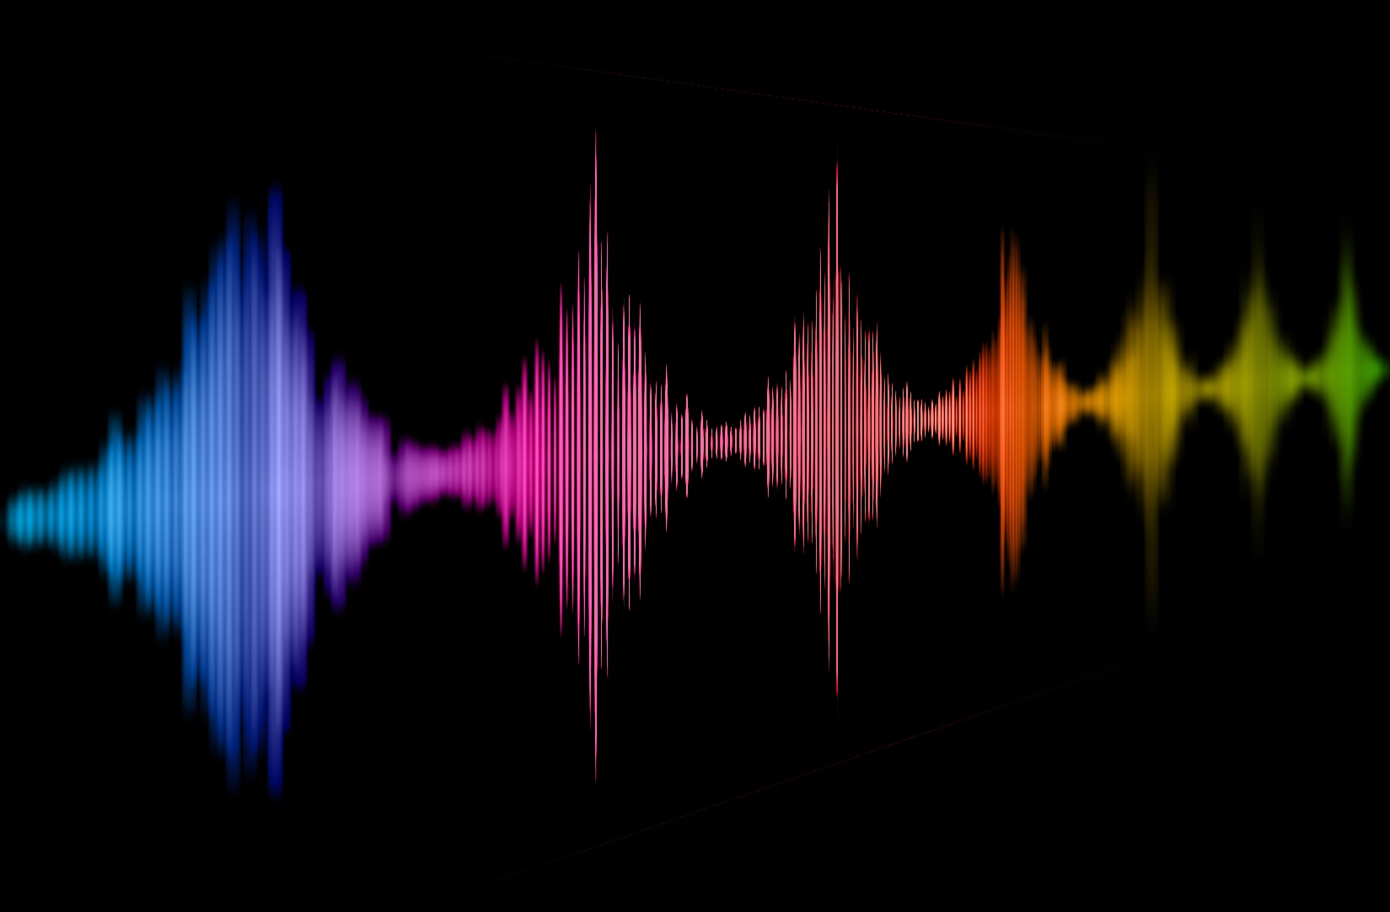
Do I sound odd to you? – Perceived naturalness in voices
Christine Nussbaum
General Psychology and Cognitive Neuroscience
PSY-UP 2025, Jena 14.01.2024
Naturalness of voices
Notes:
No data
Next 7 minutes is an advertisement talk, why I think we should study naturalness
Conceptual work

Slide 2
Who of you…
…owns a smart home device with a voice assistant?
… almost lost their temper while trying to communicate with a synthetic voice assistent in a service hotline?
… suffered through a meeting/talk because the speaker had such a bad cold (or another type of voice condition) that it was almost painful to listen?
… played around with voice manipulation tools (like voice morphing or pitch transformation) and accidently ended up with some undesired artefacts in the vocal material?
Naturalness in voices

Slide 3
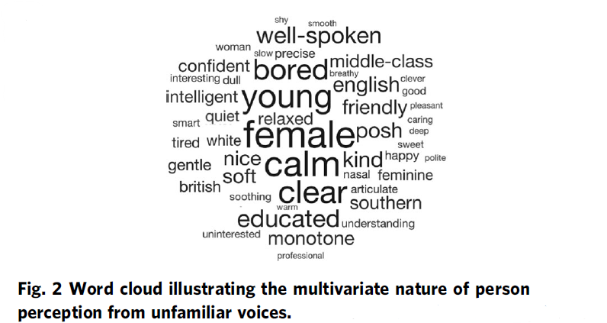
unhealthy
Person Perception from Voices
weird
machinelike
artificial
odd
strange
robotic
distorted
bizarre
[Lavan & McGettigan, 2023; Lavan 2023]
Notes:
-tremendous impact on communicative quality

Slide 4
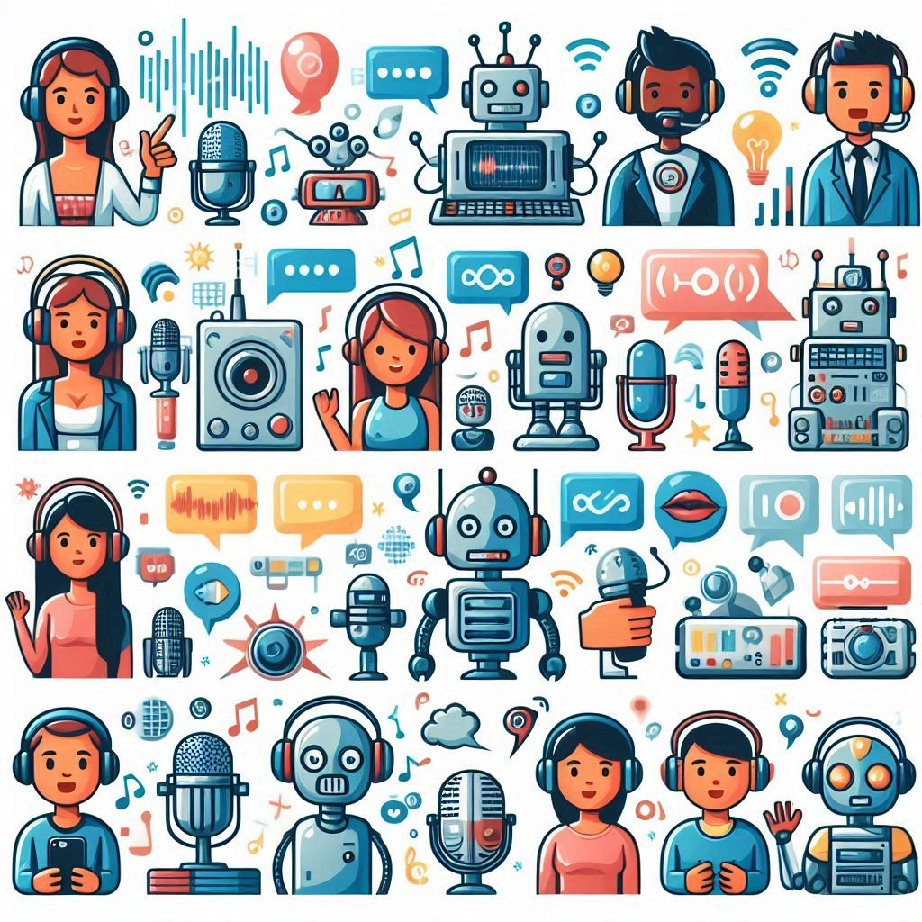
Who is talking?
“It sounds like my toaster is speaking to me.”
[Kühne et al. 2020]
AI-Image created with Bing
[Nussbaum et al., in Revision in Trends in Cognitive Sciences]

Slide 5
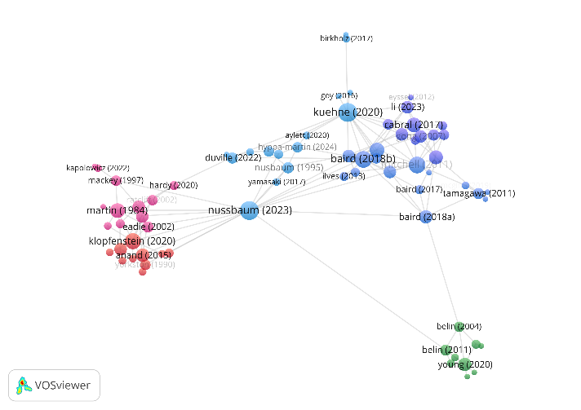
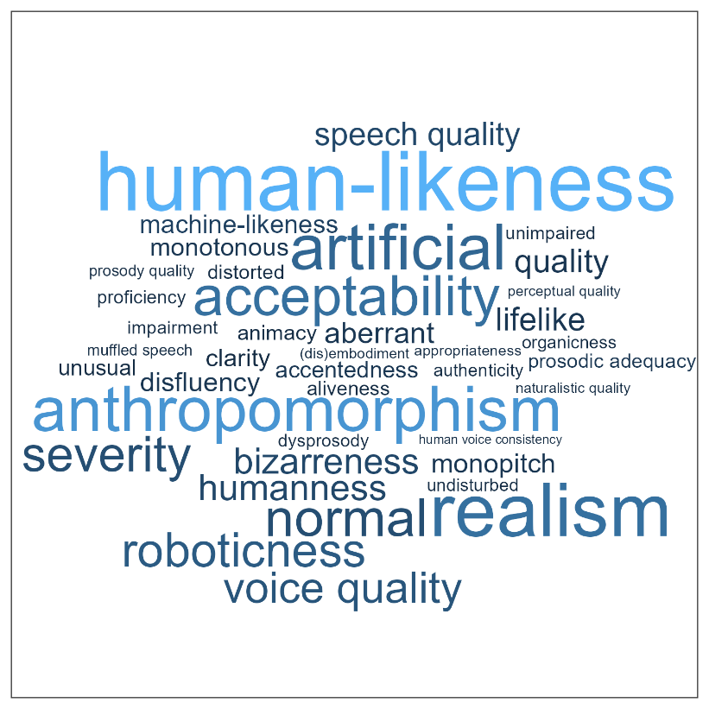
Challenges in voice naturalness research
Conceptual underspecification
Inconsistent operationalization
Lack of exchange between different research domains
Insufficient anchoring in voice perception theory
[Nussbaum et al., in Revision in Trends in Cognitive Sciences]

Slide 6
Understanding Voice Naturalness (2025)
Christine Nussbaum, Sascha Frühholz and Stefan R. Schweinberger
In Revision in Trends in Cognitive Sciences
A conceptual framework for the definition of voice naturalness

Slide 7
And now a little advertisement block…

Slide 8






Call for
A consortium with 22 members
19 DOCTORAL CANDIDATES
Join our research projects and receive
a qualified and experiential training!
BECOME A VOICE RESEARCHER IN:
Cognitive sciences
Acoustics
Phonetics
Computing science
More information:
www.vocs.eu.com

Slide 9
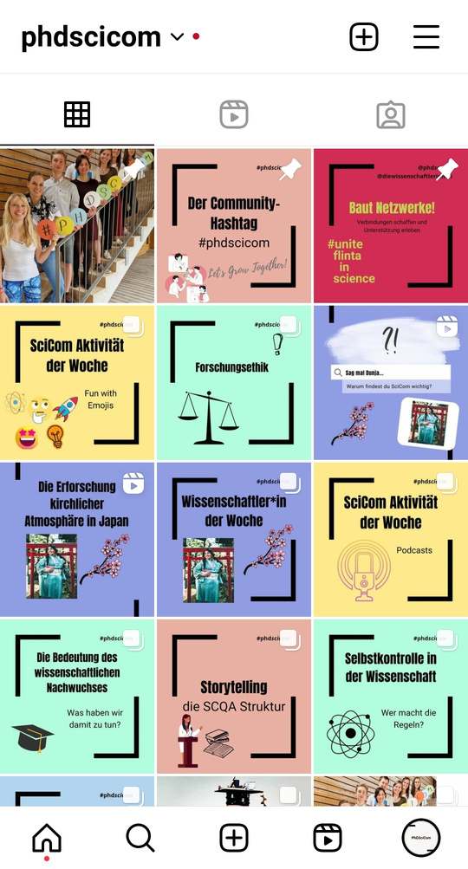




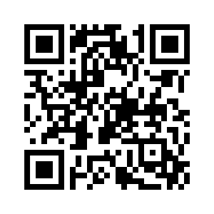
PhDSciCom e.V.
Die WissKomm Initiative
für Nachwuchswissenschaftler*innen
PhDSciCom

Slide 10
Thank you for your attention ☺

